Slide 1

BrainHack Real-Time BCI Stream: EEG Pong
Hashim, Jason, Kalman & Elijah

Slide 2
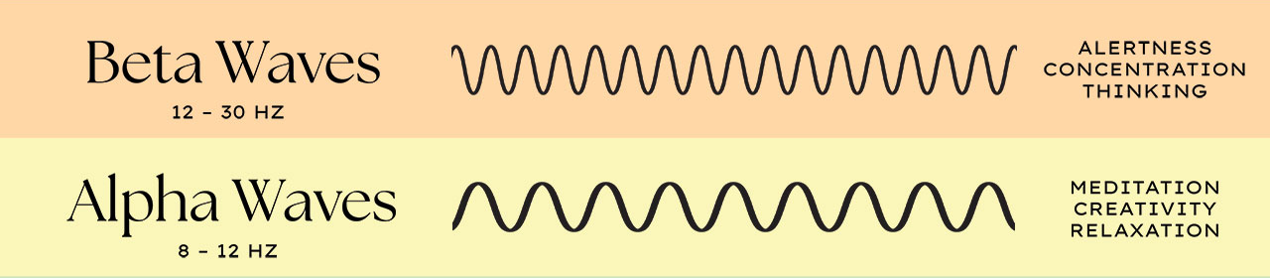
Introduction
Electroencephalography (EEG)
Electrogram of postsynaptic potentials of pyramidal neurons
Brain Computer Interface (BCI)
Interaction between brain and machine
Idea: use beta/alpha signal intensity ratio for controlling a game
[1]

Slide 3
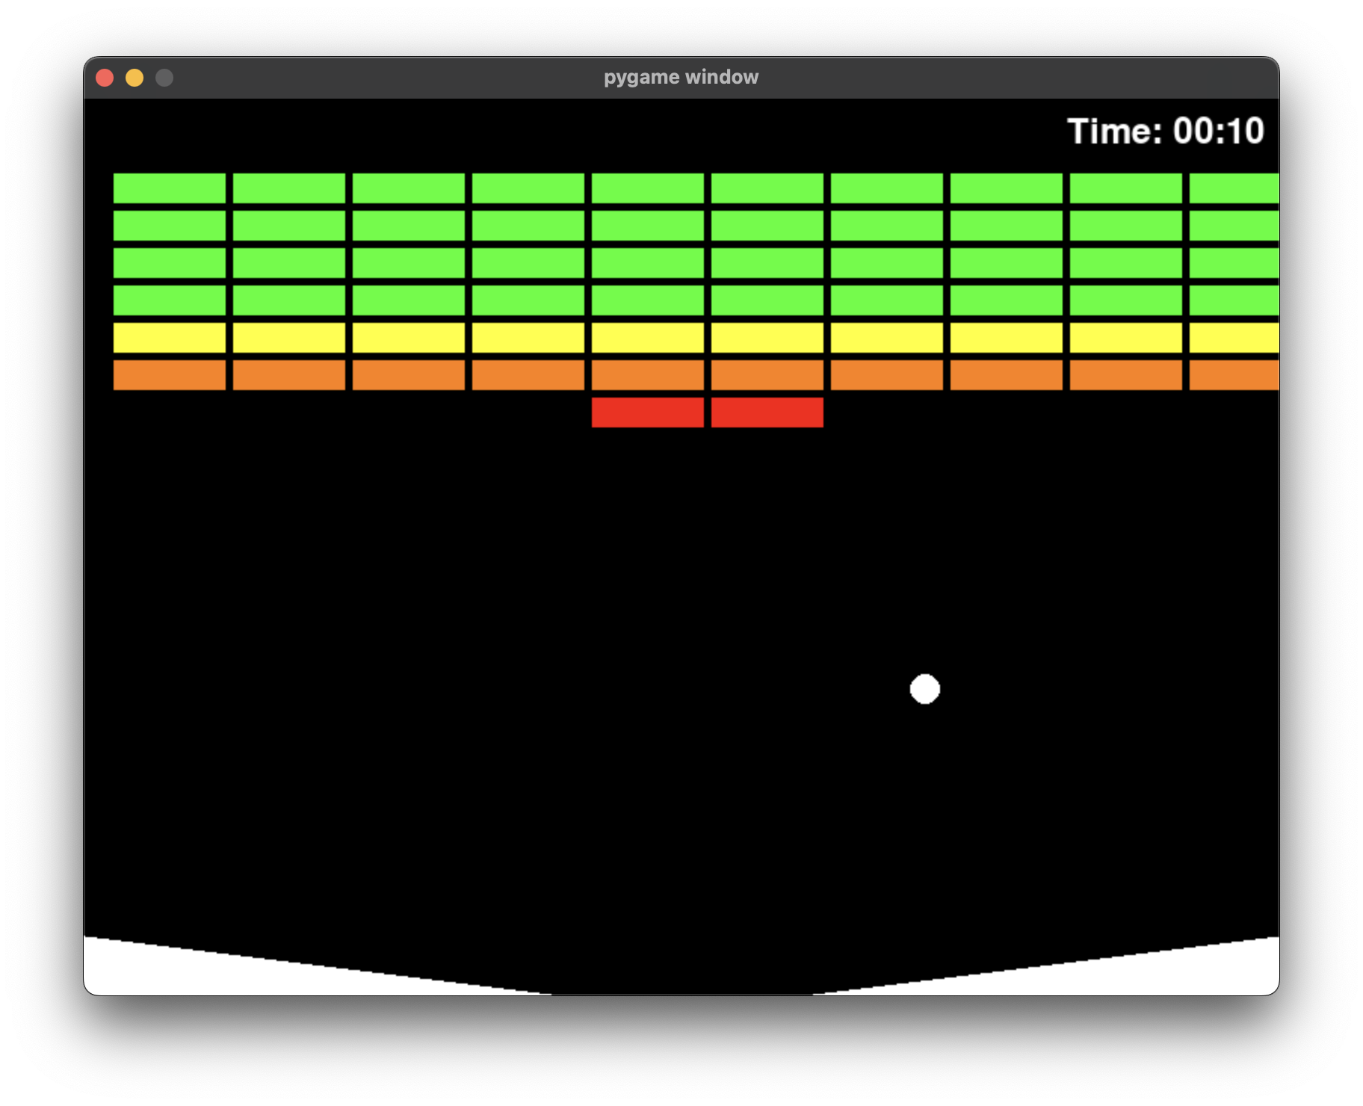
Concept: Breakout‑Style Pong

Slide 4
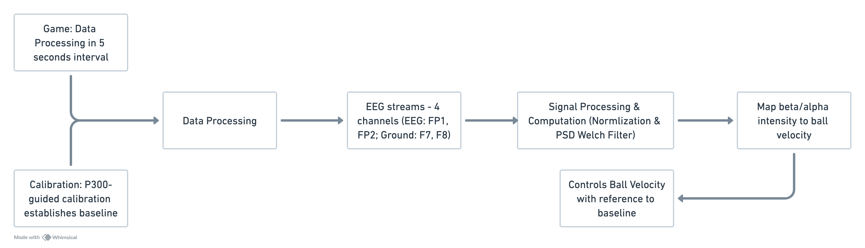
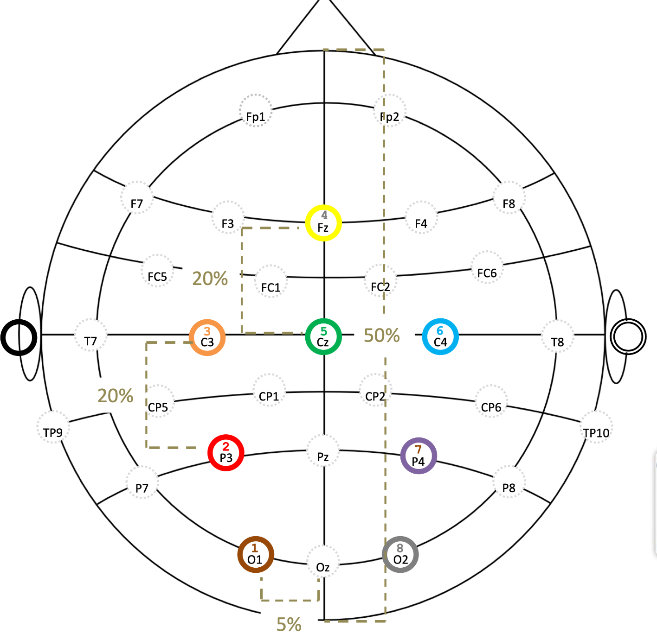
System Design
FP1
FP2
F7
F8

Slide 5
Implementation Details
Languages: Python
Notable libraries:
Pygame for game environment
BrainFlow for BCI data processing
Code availability: GitHub
Notes:
Data collection: EEG headset streams raw data over 4 channels (EEG:FP1, FP2; Ground: F7, F8)
Pre-processing: normalization around mean
Calibration: P300‑guided calibration establishes baseline
Signal processing:
compute average beta/alpha band‑powers for each channel
and compute welch PSD
Real‑time mapping: mapping beta/alpha intensity to ball velocity

Slide 6
Live Demo

Slide 7
Results & Discussion
Higher brain activity is required to increase velocity
Challenges:
noise (reduced by normalization)
connection issues with OpenBCI cyton board
unfamiliar with BrainFlow
baseline calibration is difficult due to small data size

Slide 8
Conclusion
BCI is very cool!

Slide 9
Questions, concerns, complaints?

Slide 10
References
[1] https://www.google.com/url?sa=i&url=https%3A%2F%2Fwww.diygenius.com%2Fthe-5-types-of-brain-waves%2F&psig=AOvVaw3bNlqNjwM4up2zDRkM2Q4k&ust=1758548609567000&source=images&cd=vfe&opi=89978449&ved=0CBUQjRxqFwoTCJi8mZv-6Y8DFQAAAAAdAAAAABAE

